Slide 1
Week 5 – Nunit details
QA Automation Course

Slide 2
Dido Demo – how to run Nunit tests within Visual studio

Slide 3
Selectors game

Slide 4
Homework review

Slide 5
Selectors how to
Try to locate element within LOGICAL modules
Use max 2-3 steps to locate an element
In selectors there should be words that has HUMAN meaning like: header, footer, left column, Search module, Some other module; Don’t use words like “content-wrap content-fluid” “bg-gray-light”
Try to locate the element in human words first, like: “this is the last green button in the search module” or “this is the hidden SEO text”
Always try to find what makes the element unique

Slide 6
What we’ll do today
How to run Nunit tests within Visual studio
Nunit Attributes
Nunit Assertions and Warnings – postponed: next week
WebDriver.Url WebDriver.Title – postponed: next week

Slide 7
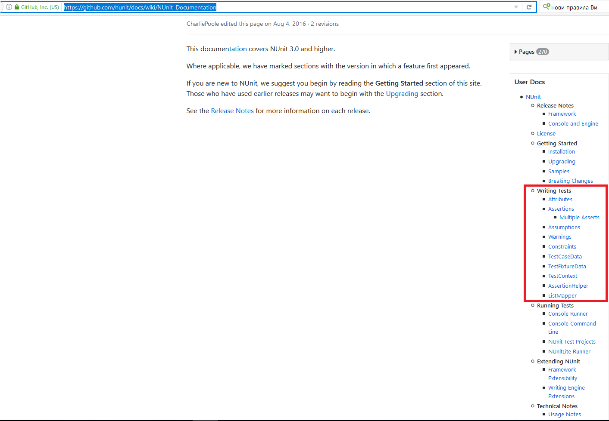
Nunit
Nunit home https://github.com/nunit/docs/wiki
Nunit documentation https://github.com/nunit/docs/wiki/NUnit-Documentation

Slide 8
Nunit Attributes (1)
[Test] [TestFixture]
[Test] – marks method as test
[TestFixture] – marks class as a test suite
[SetUp] [TearDown]
Executed before/after EACH test in the current Fixture
[OneTimeSetUp] [OneTimeTearDown]
Executed before/after ALL tests in the current Fixture
Demo Simple SettingUpAndTearingDown

Slide 9
Nunit Attributes (2)
[Author]
[Test]
[Author("Joe Developer")]
public void Test1() { /* ... */ }
[Category]
[Test]
[Category("Long")]
public void VeryLongTest() { /* ... */ }
[MaxTime ]
[Test, Maxtime(2000)]
public void Test2() { /* ... */ }
[Ignore]
[Test, Ignore("Ignore a test")]
public void IgnoredTest()
{ /* ... */ }

Slide 10
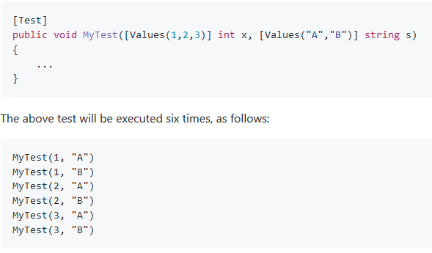
Nunit Attributes (3)
[Values]
[TestCaseData]
TestCaseSource + TestCaseData

Slide 11
Homework
Copy all your tests from the Tests class to the class named on you. Please, do not delete anything from the Tests class.
Try to improve the selectors of your tests
Optional homework: Choose at least 5 pages, and on each of them check all the Header links are present
Hint: use [TestCaseData] without ExpectedReuslt part. Pass the address of the page you are testing as String argument of the test.

Slide 12
Sources:
1. https://github.com/nunit/docs

